Slide 1
ASSISTED LIVING PROJECT
Ritwik Dutta

Slide 2
0VERVIEW 0F CURRENT W0RK
End user goes to the root website and clicks authorize
Frontend OAuth2 implementation flow redirects to Jawbone account login
Redirected temporary authentication token sent to server side Python CGI script
Script requests data from API by including Authentication tokens in the header
Script returns relevant data to JavaScript to be formatted and displayed

Slide 3

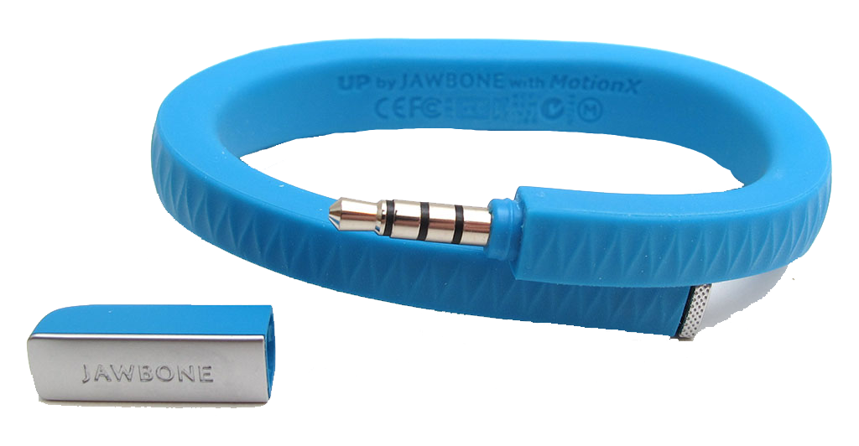
AUTHENTICATION FL0W

